Slide 1
JSTL LoginLogout with Session
Using JSP and JSTL, you need to create four files, - login.jsp, loginAuthenticate.jsp, menu.jsp, and logout.jsp.

Slide 2

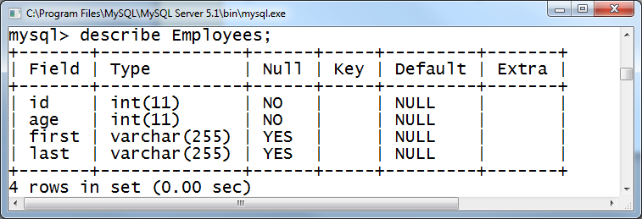
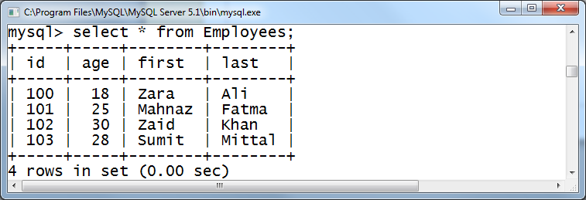
MySQL database

Slide 3
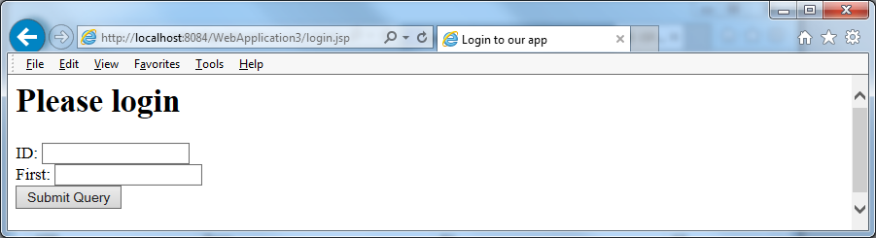
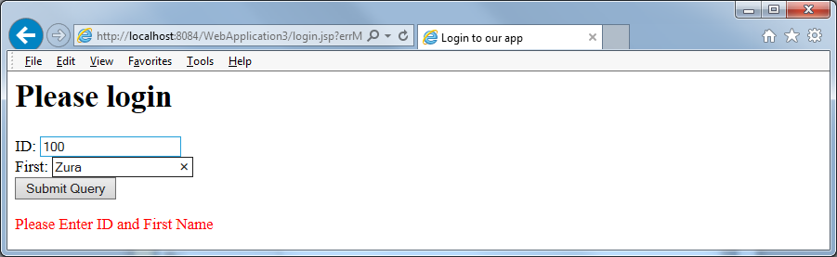

Slide 4
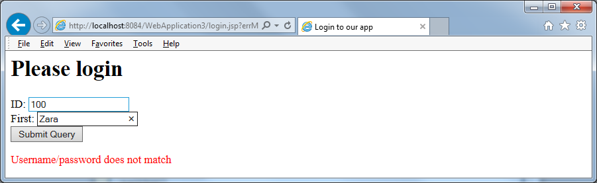
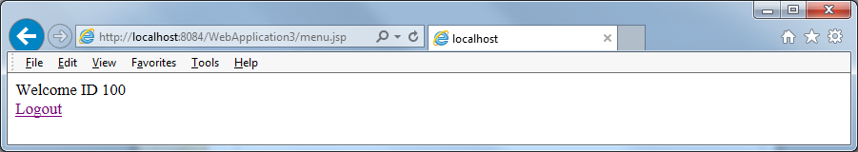
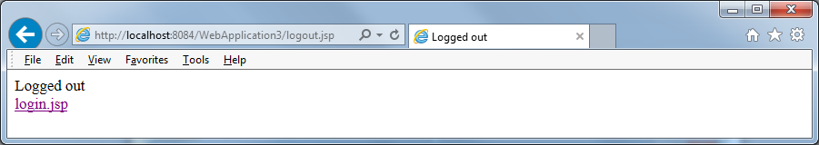

Slide 5
Code sample – login.jsp
<font color="red">
<c:if test="${not empty param.errMsg}">
<c:out value="${param.errMsg}" />
</c:if>
</font>
<form action="loginAuthenticate.jsp" >
ID: <input type="text" name="id"/><br/>
First: <input type="text" name="fn"/><br/>
<input type="submit" />
</form>

Slide 6
Code sample – loginAuthenticate.jsp
select count(*) as kount from Employees
where id='${param.id}' and first='${param.fn}'
<c:if test="${ empty param.id or empty param.fn}">
<c:redirect url="login.jsp" >
<c:param name="errMsg" value="Please Enter ID and First Name" />
</c:redirect>
<c:if test="${not empty param.username and not empty param.password}”>

Slide 7
<c:forEach items="${selectQ.rows}" var="r">
<c:choose>
<c:when test="${r.kount gt 0}"> <!– greater than 0 -->
<c:set scope="session" var="idNo" value="${param.id}"/>
<c:redirect url="menu.jsp"/>
</c:when>
<c:otherwise>
<!– redirect to login.jsp, with msg-ID/firstname not match.-->
</c:otherwise>
</c:choose>
</c:forEach>

Slide 8
Code sample – menu.jsp and logout.jsp
<c:if test="${empty sessionScope['idNo']}">
<c:redirect url="login.jsp" />
</c:if>
======================
<%
session.removeAttribute("idNo");
%>

